Slide 2
Clarify purpose to inform (re) design
Focus on business relevant results
Improve conditions to
optimise impact

Slide 3
One setting: two coaching case examples
Linking Measures to Purpose

Slide 4
Case 1: Clarifying & articulating expected outcomes (purpose)
For staff
Psychological Safety Process difficult experiences Engage with strong emotions
Increase in positive coping behaviours and self-management strategies
Value for organisation
Maintain workforce during the pandemic
Maintain Well-being & Resilience
(Reduce burnout)
Inform future employee wellbeing planning

Slide 5
Case 1: Collecting data relevant to outcomes
Survey data collected from the same staff three times: before coaching, after and again at follow up
Comparison group, to give more confidence in results
Survey requests sent via IT booking platform
Independent analysis (by IES)

Slide 6
Source: IES, 2021

Slide 7
Source: IES, 2021

Slide 8
Source: IES, 2021

Slide 9
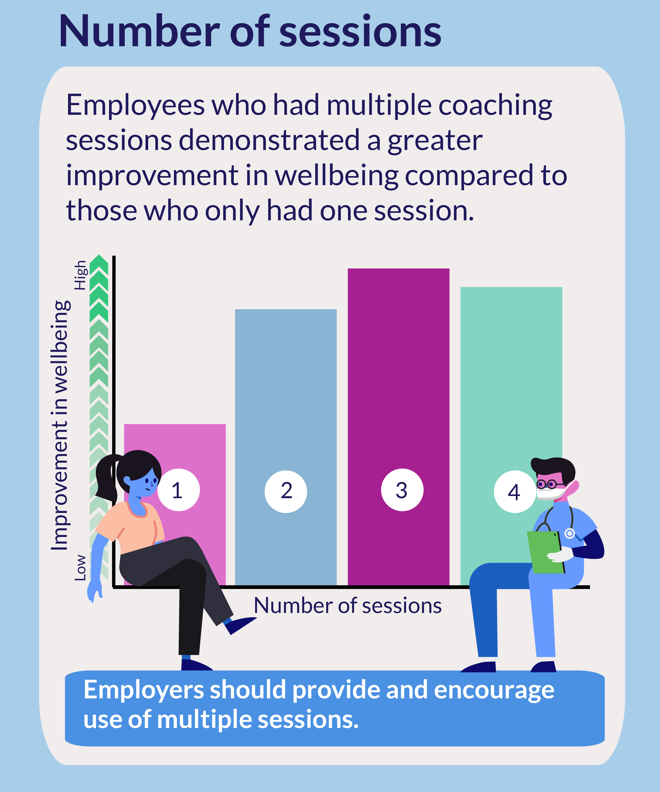
Source: IES, 2021

Slide 10
Clarify purpose to inform (re) design
Focus on business relevant results
Wellbeing
Resilience
Short-term
Improve conditions to
optimise impact
Multiple sessions
Follow-on pathways
Longer term?

Slide 11
Case 2: Clarifying & articulating expected outcomes (purpose) For staff Value for organisation
Change in Thinking Self-awareness Opportunity Awareness Career Planning Career Management Skills
Taking Career Actions
Change in Attitudes & Feelings Feeling calmer & clearer Feeling supported Confidence Able to take ownership
Positive Career Expectations
Retention Reduced intention to quit
Participation Intention around amount of work/length of career
Reduction in Burnout

Slide 12
Case 2: Collecting data relevant to revised purpose
Prompted journals
227 coachees
submitted entries before, during, and/or after coaching
Impact surveys
124 coachees
completed surveys before and immediately after coaching
51 coachees completed surveys before and up to 22 months after coaching
Notes:
In speaking to this slide – update re second wave of data collection as well as reflecting on the first wave and what it is analysis they will see

Slide 13
Short-term effects: Cognitive Career Planning statements, average agreement
Note: * denotes statistically significant difference (p<0.05) between pre- and post-coaching surveys
Source: IES, 2024

Slide 14
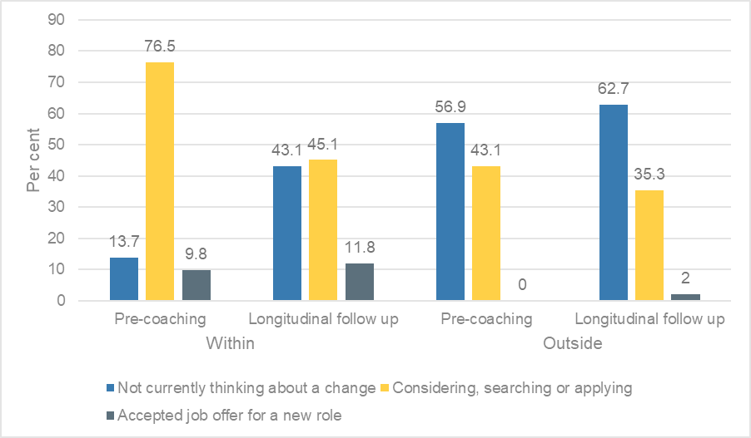
Longer term effects - Intention to change role
Source: IES, 2024

Slide 15
Top Tips from IES and other employers
Know why coaching is happening
Keep data collection simple
Consider the audience for your results and what data will be credible and relevant to them
Compare results from coached with a group of non‐coached (or not yet coached) if you can
There is power in a good story (narrative)
Be realistic: Corporate barriers limit what can be achieved from coaching
A focus on business impact gives you the evidence needed to write successful business cases
Keep a handle on financing
Use data for interim stock-takes of any improvements needed
Get coaches activated in support of your purpose and data gathering and keep them informed
Privacy and anonymity can be in tension with tracking individuals so be transparent and seek consent before coaching begins

Slide 16
About IES: The Institute for Employment Studies (IES) is an independent, apolitical, international centre of research and consultancy in public employment policy and HR management. It works closely with employers in all sectors, government departments, agencies, professional bodies and associations. IES is a focus of knowledge and practical experience in employment and training policy, the operation of labour markets, and HR planning and development. IES is a not-for-profit organisation. www.employment-studies.co.uk
Alison.carter@employment-studies.co.uk
Follow IES on Twitter @EmploymtStudies and LinkedIn Institute for Employment Studies

